Slide 1
Biostatistics & Experimental Design
Qian, Wenfeng

Slide 2
Self introduction
Qian, Wenfeng (钱文峰)
Institute of Genetics & Developmental Biology, CAS
Center for Molecular Systems Biology

Slide 3
My research
Genetic basis of gene expression
Expression variations among species
Expression variations among environments
Expression variations among isogenic cells
Genetic-environment interactions
Kinetics of gene expression
Protein synthesis/degradation
Transcriptional/translational burst

Slide 4
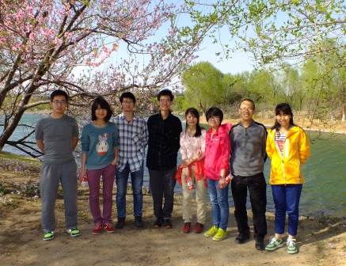
My group
http://qianlab.genetics.ac.cn/

Slide 5
My education
2006, B.S., Peking University
Biological Sciences
2012, Ph.D., University of Michigan
Evolutionary genetics

Slide 6
Statistics and me
Top 1% statistics among biologists
Top 1% biology among statisticians

Slide 7
Course introduction
Applied biostatistics
Examples, examples, and examples
Try to make it not too heavy

Slide 8
Schedule
April 22: Probability
April 24: Introduction to R
April 29: Hypothesis testing
May 6: Analysis of covariance
May 8: Regression and correlation
May 13: Plots with R
May 15: Presentations (== final exam)
Prof. Yang

Slide 9
R language
Standard statistical tool in science
Will be introduced by Prof. Yang
You will need to bring your laptop to the class, with R installed.

Slide 10
Download R
http://www.r-project.org/

Slide 11
Exam
Final exam is a report based on the use of statistics in a small project. The report should be between 1000 and 2000 words.
Ten-minute (including 2 min Q & A) oral defense of the report in front of the class.

Slide 12
PPT
Will be uploaded to my lab website after each class
qianlab.genetics.ac.cn
Words in red: waiting for your response
Words in green: the beginning of a new example

Slide 13
Your introduction

Slide 14
Statistics is the base of all sciences
The definition of the modern science?

Slide 15
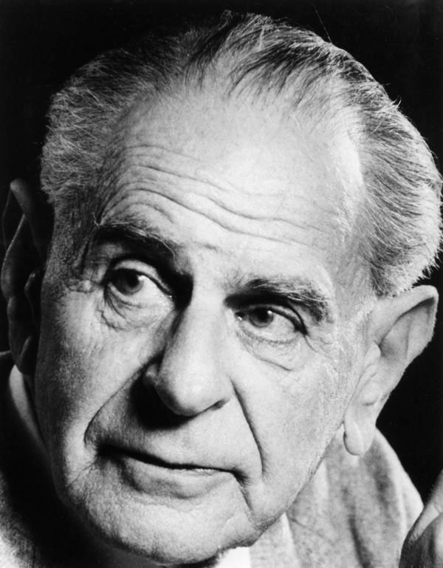
What is science?
A theory in the empirical sciences can never be proven, but it can be falsified, meaning that it can and should be scrutinized by decisive experiments.
Hypothesis testing
Karl Popper 1902-1994

Slide 16
Statistics
Statistics is the study of the collection, organization, analysis, interpretation and presentation of data.

Slide 17
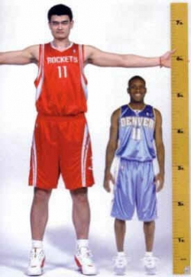
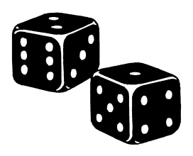
Deterministic vs stochastic events
Deterministic events
Stochastic events
If I roll a dice, I will get a face up
I will get up in the tomorrow morning
A child will grow up
The number on the face up
The exact time (minute and second) I get up
The height and weight of the child
Other examples?

Slide 18
Phenomena in biology
Are likely to be stochastic, compared to physical phenomena
In physical world
Sun rises
Planet moves
Water boils

Slide 19
In biological world
Weight and height
Disease
Life span
Reason?

Slide 20
Reasons of stochasticity in life
Traits are determined by both genes and environments
Environment is heterogeneous
Most traits are affected by multiple genes with minor effect each
Developmental strategy (body plan)
Life sciences contains a huge number of factors, which makes stochasticity everywhere.

Slide 21
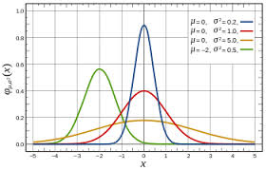
Normal distribution
The bell shape
Appears everywhere in biology
Why?
Traits are determined by both genes and environments
Many genes with minor effects
Additivity
What if not?

Slide 22
The height is more than 1.9 meter
If the distribution of height follows normal distribution, with mean = 1.75 and standard deviation = 0.06

Slide 23
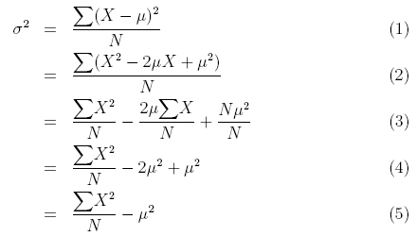
Descriptive statistics
Mean
Variance (σ²)
Standard deviation (σ)

Slide 24
The height is more than 1.9 meter
If the distribution of height follows normal distribution, with mean = 1.75 and standard deviation = 0.06
P = 1- “NORMDIST(1.9, 1.75, 0.06, 1)”
=0.6%

Slide 25
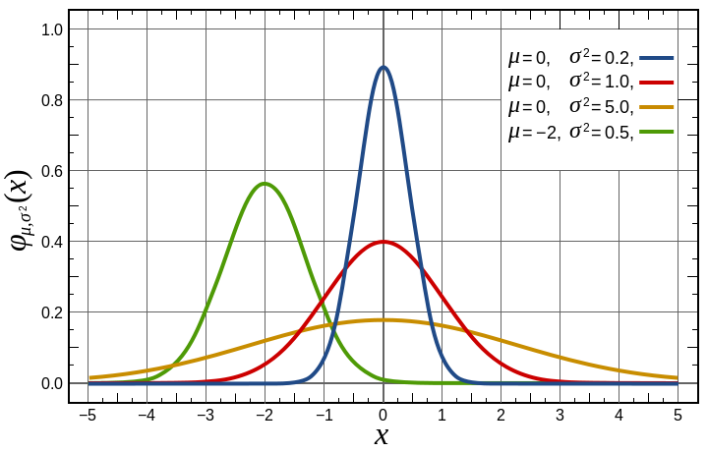
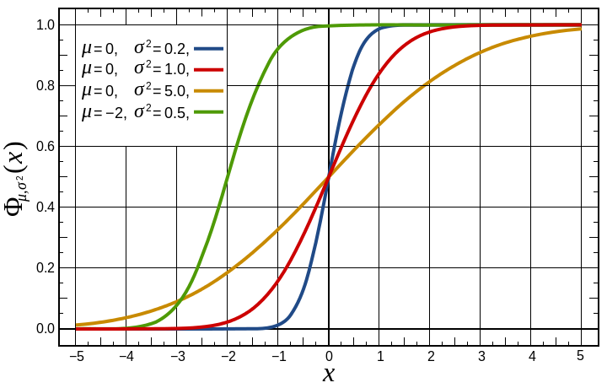
Density function
Cumulative density function

Slide 26
The height is more than 1.9 meter
If the distribution of height follows normal distribution, with mean = 1.75 and standard deviation = 0.06
What is the probability of less than 1.2 meter?

Slide 27
The height is more than 1.9 meter
If the distribution of height follows normal distribution, with mean = 1.75 and standard deviation = 0.06
What is the probability of less than 1.2 meter?
What if this number is different from what has been reported?

Slide 28
Regression to the mean
In statistics, regression toward (or to) the mean is the phenomenon that if a variable is extreme on its first measurement, it will tend to be closer to the average on its second measurement
An positive gene in your screen may not appear in the next time.
The best student in the collage could become ordinary later in his/her career
Why? Any examples?

Slide 29
How do we treat stochastic data
At a summer tea party in Cambridge, England, a guest states that tea poured into milk tastes different from milk poured into tea. Her notion is shouted down by the scientific minds of the group.
But one man, Ronald Fisher, proposes to scientifically test the hypothesis.

Slide 30
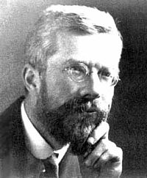

Slide 31
How to test the hypothesis?
H₀: There is not difference on order of milk and tea

Slide 32
How to test the hypothesis?
H₀: There is not difference on order or milk and tea
10 cups of drink
Mixed blind to the lady
Let the lady tell the order of milk and tea
If H₀ is correct, what is the probability the lady get all 10 guess correct?

Slide 33
How to test the hypothesis?
If H₀ is correct, what is the probability the lady get all 10 guess correct? 0.1%
It is unlikely that event with such low probability happened in a single test. Thus, the most likely scenario is that H₀ is incorrect, and there is differences between two orders.

Slide 34
What if…
Among 10 tests, the lady succeeded for 8 of them?

Slide 35
Binomial distribution
First, child Boy or Girl
Second, B or G
Third, B or G
Eight possibilities:
BBB, BBG, BGB, BGG, GBB, GBG, GGB, GGG
What is the probability of having 2 B in 3 children?

Slide 36
Binomial distribution
$P\left(x=k\right)=\left({n \atop k}\right)p^{k}{(1−p)}^{n−k}$
n=3
k=2
p=0.5

Slide 37
What if…
Among 10 tests, the lady succeeded for 8 of them?

Slide 38
Probability estimation
Alternatively, we can estimate the probability of success (E)
In this case 80%
Then, we can get 95% confidence interval (CI)
If E – CI > 0.5, we conclude a difference between the order

Slide 39
How to calculate confidence interval?
For binomial distribution,
Variance $σ^{2}=npq$
Standard deviation $σ=\sqrt{npq}$
In this case, σ = sqrt(10 * 0.8 * 0.2) = 1.26
If we use normal distribution to approximate the binomial distribution
95% confidence interval = [μ-2σ, μ+2σ]
=[8-2.5, 8+2.5] = [5.5, 10.5]
5 is out of the 95% confidence interval
Implications

Slide 40
Law of large number
The estimate of the probability 0.8 may not be accurate …
The larger the sample size, the more accurate our estimate is.
So that we could potentially distinguish 50% from 60%

Slide 41
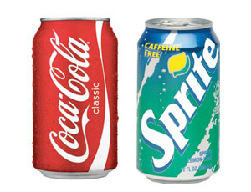
Applications of such idea
Hold your nose, and you may not able to tell coke from sprite

Slide 42
Is a drug effective or not?
Other examples?

Slide 43
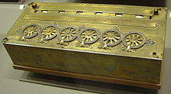
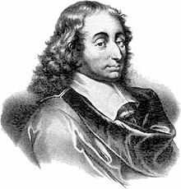
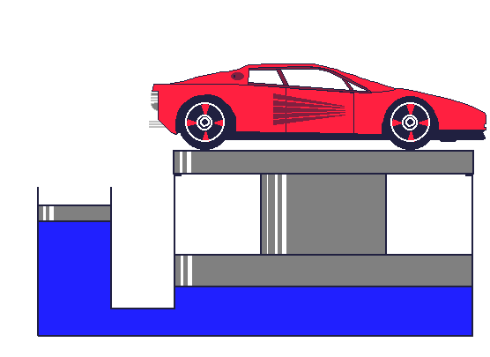
Blaise Pascal
Pascal calculator
1623-1662
Pascal's principle

Slide 44
Geek’s joke
One day, Einstein, Newton, and Pascal meet up and decide to play a game of hide and seek. Einstein volunteered to be “It.” As Einstein counted, eyes closed, to 100, Pascal ran away and hid, but Newton stood right in front of Einstein and drew a one meter by one meter square on the floor around himself. When Einstein opened his eyes, he immediately saw Newton and said “I found you Newton,” but Newton replied,

Slide 45
Einstein, Newton, and Pascal Play Hide and Seek
“No, you found one Newton per square meter. You found Pascal!”.

Slide 46
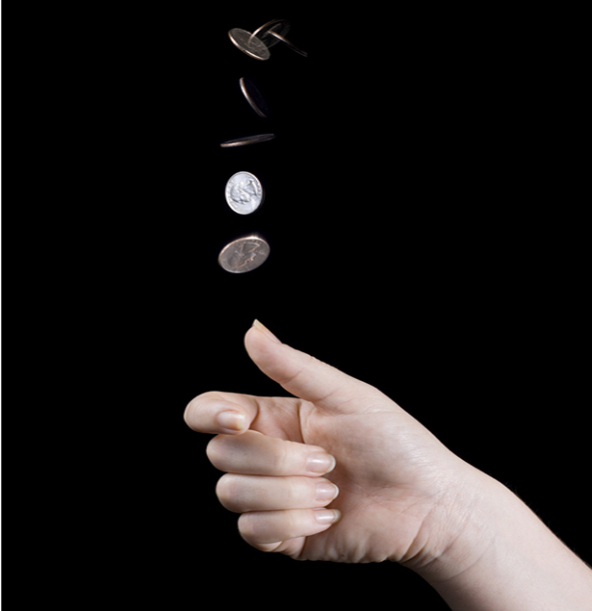
Pascal’s Problem
The rule of the game
Two people toss the coin one by one
They both bet 12 coins
Player A wins when s/he gets 3 “head”
Player B wins when s/he gets 3 “tail”
The game has to stop when A gets 2 “head” and B gets 1 “tail” because of King’s call
How to split the bet?

Slide 47
Opinions
B: A gets 2/3 and B gets 1/3
A needs one more “head”, P = 1/2
B needs two more “tails”, P = 1/4
A: A gets 3/4 and B gets 1/4
B wins only when B gets two “tails” P = 1/4
Otherwise, A wins P = 3/4
Who is correct?

Slide 48
Conclusion
A: A gets 3/4 and B gets 1/4

Slide 49
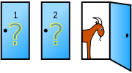
Monty Hall problem
Suppose you're on a game show, and you're given the choice of three doors: Behind one door is a car; behind the others, goats. You pick a door, say No. 1, and the host, who knows what's behind the doors, opens another door, say No. 3, which has a goat. He then says to you, "Do you want to pick door No. 2?" Is it to your advantage to switch your choice?
Your guess?

Slide 50
Monty Hall problem
If the car is not behind door 3, the probabilities of being behind door 1 and door 2 are equal
P = ½ for both.

Slide 51
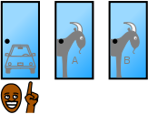
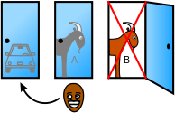
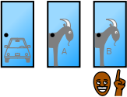
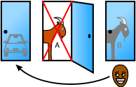
Solution 1
1/3
1/3
1/3

Slide 52
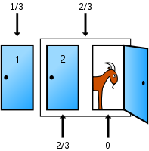
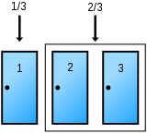
Solution 2

Slide 53
Solution 3

Slide 54
Consider 10000 doors …
You chose door 1
The host open 9998 doors for you, and none of them have cars behind
Do you switch?

Slide 55
Monty Hall problem
Switch it!

Slide 56
The probability of the same birthday in a class
Consider a class with 50 people
What is the probability that at least two students have the same birthday?
Your guess?

Slide 57
The probability that all have different birthday
The first person: 1
The second person: 364/365
The third person: 363/365
…
The 50th person: 316/365
P = 0.03

Slide 58
The answer
The probability that all have different birthdays
P = 0.03
The probability that at least two students have the same birthday
1 – P =0.97

Slide 59
The probability of selfing
A rice is a monoecious plant
Male flower and female flower have different timings.
Male flowers blossoms for 5 days
Female flowers blossoms for 3 days
It is estimated that male flower may blossom during June 5 - 10, and female flower may blossom during June 1 – 15
The probability of selfing?

Slide 60
The probability of selfing
Male 5d; Female 3d
Male flower may blossom during June 5 - 10
Female flower may blossom during June 1 – 15

Slide 61
The success of an experiment
Two people A and B are doing an experiment in my lab
According to the history records, the successful rate for A is 0.8, and that for B is 0.7
Each of them does the experiment once
What is the probability of at least one success?

Slide 62
The success of an experiment
Consider the probability both of them fail
P = 1- 0.2 * 0.3 = 0.94
Any problems here?

Slide 63
The success of an experiment
Consider the probability both of them fail
P = 1- 0.2 * 0.3 = 0.94
Any problems here?
It depends on whether the two people are doing experiments independently!
Do they use the same set of reagents?
If true, then A’s failure increases the probability of B’s failure

Slide 64
The conditional probability
P(A|B)
The probability of A given B
The probability of girl given the first child is a boy in the family
P(the second child is a girl | the first child is a boy)
If independent P (2nd girl | 1st boy) = P (girl)

Slide 65
Autosomal single-locus disease
Patients
Normal individuals
?

Slide 66
Autosomal single-locus disease
Patients
Normal individuals
?

Slide 67
Bayesian theorem
$P\left(A_{i} \right| B)= \frac{P\left(A_{i}\right)P\left(B \right| A_{i})}{\sum_{i=1}^{∞}{P\left(A_{i}\right)P\left(B \right| A_{i})}}$
Examples?

Slide 68
Probability of infection
A test can detect 95% of the people with infection (true positive)
There is 1% probability of false positive
The frequency of a infection is 0.5%
What is the probability of infection, given a positive result in the test

Slide 69
Bayesian theorem
$P\left(A_{i} \right| B)= \frac{P\left(A_{i}\right)P\left(B \right| A_{i})}{\sum_{i=1}^{∞}{P\left(A_{i}\right)P\left(B \right| A_{i})}}$
A_{i} = infected
B = positive in the test
P (A_{i} | B)

Slide 70
Autosomal single-locus disease
Patients
Normal individuals
?

Slide 71
The probability of 4th girl in the family, given the first 3 are all girls
Your opinion?

Slide 72
Genetics or stochasticity
Model I: for some genetic reasons, only sperms with X chromosome survive.
Model II: the birth of sons and daughters are equally likely
For a family with 3 daughters, which model is more likely?

Slide 73
Genetics or stochasticity
Model I: for some genetic reasons, only sperms with X chromosome survive.
Model II: the birth of sons and daughters are equally likely
How to calculate it quantitatively?

Slide 74
Genetics or stochasticity
Model I: for some genetic reasons, only sperms with X chromosome survive.
Model II: the birth of sons and daughters are equally likely
LOD score: log₁₀ of odds
LOD = log₁₀(P(obs. | model I)/ P(obs. | model II))
Why?

Slide 75
Genetics or stochasticity
Model I: Genetics
Model II: By chance
LOD = log₁₀(P(obs. | model I)/ P(obs. | model II))
P(obs. | model I) = 1
P(obs. | model II) = 1/8
LOD =log₁₀(1/8) = -0.9
Threshold: >3 or <-3

Slide 76
Number of left handed people
If the probability of left handed people is 5% in a population, what is the probability of a 50-student class containing exact 1 left handed people?

Slide 77
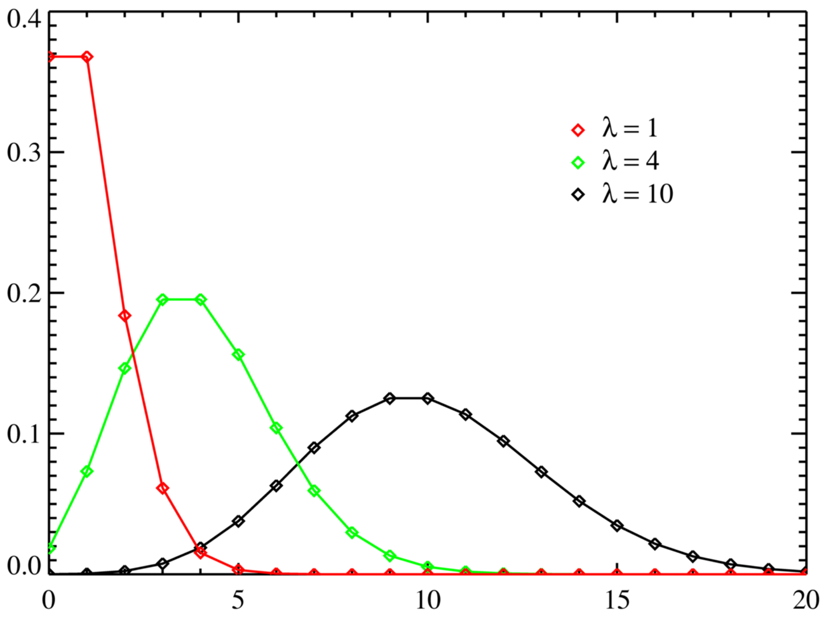
Poisson distribution
λ = mean = variance

Slide 78
Number of left handed people
Poisson distribution
λ = 50* 5% = 2.5
P(X = 1) = $\frac{2.5×e^{−2.5}}{1!}$ = 20%
How about 0, 2, 3, 4 left handed people?

